Slide 1
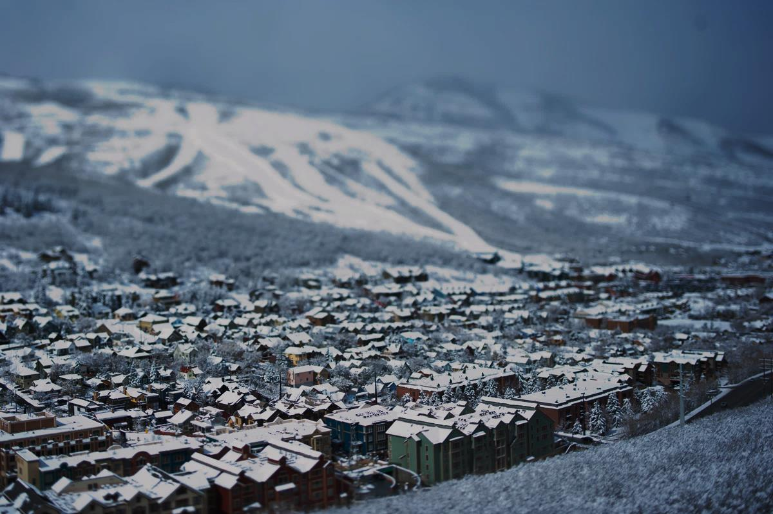

City Manager’s
FY23 Recommended Budget

Slide 2
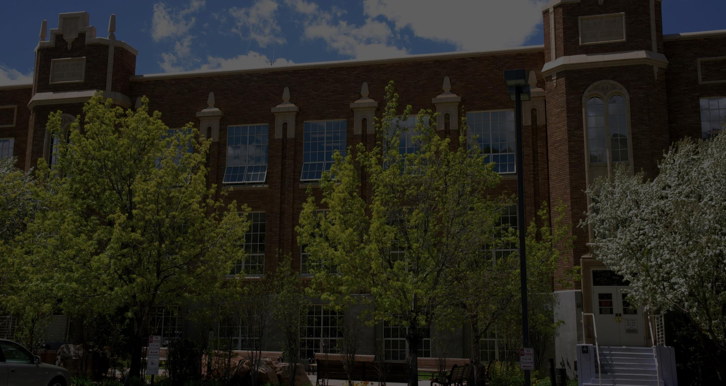
Timeline

Slide 3
Budget Timeline
May 26
Operating Budget Overview
June 9
Capital Budget Overview
June 16
Fee Changes, Policies, Compensation Ordinance, etc.
June 23
Final Budget Adoption

Slide 4

Summary

Slide 5
Key Budget Themes
$3.5M – General Fund
3. Neighborhood Reinvestment $797k
5. Core & Essential Services $1M
1. Organizational Infrastructure $725k
Increased neighborhood patrols, code enforcement, safety, and planning efforts
Service increases related to critical priorities and existing service demands
Enhancements to data analytics, financial systems, business intelligence, etc.
1
3
5
2
4
2. Resort Economy Mitigation $855k
4. Workforce Support $268k
More resources dedicated to traffic and resort impacts
Resources to enhance recruitment, retention, and quality benefits

Slide 6
Park City FY23 Budget

Slide 7
Sales Tax Revenues through March
March 2022 marginally lower sales tax revenues as compared to February 2022
March FY22 up 29% vs. March FY21
TRT March FY22 up 51% vs. March FY21
Source: Park City Municipal Corporation. As of May 2022.

Slide 8
Budgeting for Outcomes

Slide 9
Budgeting for Outcomes
Strategic
Cost Effective
Inclusive
Comprehensive
Best Practice

Slide 10
Budgeting for Outcomes
  Recognized as a public finance best practice by:
    Government Finance Officers Association (GFOA)
    International City Managers’ Association (ICMA)
    Alliance for Innovation
  BFO (or Priority Based Budgeting) practiced by over 250 organizations across North America

Slide 11
FY23 Budget Historical Context
FY21 – Driven by Covid/Global Recession
FY22 – Cautious & Conservative Increases
Restoring critical cuts from previous fiscal year
FY23 – Stabilization Mindest
Historic Sales Tax Highs
Operating Cuts
Hiring freezes
Capital Deferrals
Community Demand for Services
Inflation (cost-of-doing business increases)
Competitive Pay & Benefits
Competitive Pay & Benefits

Slide 12









BFO Process
City Manager’s Recommended Budget
Council Retreat
Results Team
Council defines critical priorities, goals, and outcomes
Results Team reviews requests
Recommendations based on voting of team members who take into account manager’s rationale, justified need, availability of resources, and influence of BFO scoring and Council priorities
Presented to Council at first meeting in May
City Manager’s recommendation after reviewing recommendations from Results Team, CIP Committee, and Compensation Committee
Council has ability to enhance or decrease recommendation
Council Final Adopted Budget
Executive
Council adopts final budget prior to July 1
Council may adjust budget as it sees fit
Council adopts budget that reflects community priorities and outcomes
Dept Budget Requests
Results Team recommendation is presented to Executive
Executive makes decisions on what will be recommended, taking RT recommendation into account
Staff develops budget requests around Council community priorities, themes, essential services, etc.

Slide 13
BFO Program Scoring
Council Priorities/Themes/Core Services | 2.00
Portion of Community Served by Program | 1.00
Reliance on City to Provide Program | 1.00
Change in Demand for the Program | 1.00
Mandated to Provide Program | 1.00
Effectiveness of Proposal | 0.75
Cost Recovery of Program | 0.50
Cost Savings/Innovation /Collaboration | 0.25
Criteria & Weighting

Slide 14
Program Scoring by Theme

Slide 15
Council/Staff Roles
Council
Define Priorities/Goals
Focus on Policy/Outcomes
Managers
Design Budget Requests based on Council Goals
Executive/Budget
Evaluate Priorities from an Organization-wide Perspective
Recommend Budget to Council based on Council Pillars/Priorities
Anticipate Department Needs/Costs

Slide 16
Council’s Role
  Defines community priorities & goals
  Reviews and amends appropriations based on community priorities & goals
  Decides on the level of public engagement
  Has transparent access to listing of all programs offered along with associated costs and FTEs
  Educates themselves on the variety and diversity of programs offered
  Focus on POLICY & OUTCOMES rather than OPERATIONS
  Ensures allocated resources are based on priorities of the community
  Makes decisions that can easily be communicated to the community

Slide 17
Defining Priorities
  Normally defined and evaluated during the Council’s Retreat
  Derived from community input: visioning, community meetings, informal conversations, etc.
  Designated areas within the City that need additional investment to combat specific problems
  Considered long-term issues that will take several years to achieve results

Slide 18
Defining Priorities
TRANSPORTATION
ENVIRONMENT
EQUITY
HOUSING

Slide 19
Defining Themes (NEW)
  Derived from Council Retreat and subsequent work sessions
  Identified areas within the City that need additional investment to combat specific problems
  Considered short-term issues for the next budget year or two

Slide 20
Defining Themes (NEW)
Resort Economy Mitigation
Neighborhood Reinvestment
Organizational Infrastructure
Workforce Support

Slide 21
Themes
Critical Priorities

Slide 22
City BFO Programs (Services)
  Budgeted ongoing citywide services
  Building blocks of the BFO Process
  Responses to a Critical Priorities & Themes
  Justification for how budget changes will produce desired outcomes
  Prioritized and scored by Council/Community Criteria
  Include the total expenditure and revenue budgeted amounts as well as FTEs

Slide 23
Results Team Recommendation
  Results Team identifies questions or gaps in specific proposals and requests additional information from the proposal owner, including potential implications of level of service adjustments or the suggestion of additional collaboration
  The scoring and prioritization of the BFO programs is the start of the discussion on where to fund programs—not the end
  Decisions on budget enhancements or decreases are based on the scoring of each BFO program, as well as the department manager’s rationale, established need, and availability of resources
  Results team discusses their overall rankings and rationale for budget enhancements or decreases and prepares a final recommendation to the City Manager

Slide 24


BFO Process – Engineering Plan Review/Inspections
Engineering Budget Request
Results Team
Analyst Office Assistant: $105k
Training & Supplies: $7,450
Software Licenses: $7,145
Engineering Svs: $45k contract money
Engineering Svs: $45k traffic mitigation contract money
Training & Supplies: $2,850
Software Licenses: $7,145
Recommendation based on voting of team members
Recognized need for enhanced traffic mitigation efforts
Concerned about cost taking into account all needs
BFO Program Score – Plan Application Review
City Manager’s Recommended Budget
Score: 17, Quartile: 3
Critical Priority/Theme: 3
% of Community Serviced: 2
Change in Demand: 3
Effectiveness: 3
Mandated: 2
Reliance on City: 2
Cost Recovery: 2
Analyst Office Assistant: $105k
Training & Supplies: $2,850
Software Licenses: $7,145
Added position based on enhancement of neighborhood svcs
NTMP $ added in CIP

Slide 25


BFO Process – Parking
Parking Budget Request
Results Team
Reclass 4 Parking Officers to TDM Officers: $35k
Reclass 2 PW Analysts to Customer Svc Analysts: $22k
Subscriptions: $40k
MSS: $6k
Subscriptions: $40k
MSS: $6k
Recommendation based on voting of team members
Recognized need for inflationary increases
Reclasses needed more justification
BFO Program Score – Parking
City Manager’s Recommended Budget
+1 Additional Parking Officer + Vehicle: $127k
Subscriptions: $40k
M,S,S: $6k
Reclass 4 Parking Officers to TDM Officers: $35k
Reclass 2 PW Analysts to Customer Svc Analysts: $22k
Developed traffic mitigation team approach (across depts)
Score: 19, Quartile: 2
Critical Priority/Theme: 4
Cost Recovery: 4
Change in Demand: 4
% of Community Serviced: 2
Mandated: 2
Reliance on City: 1

Slide 26
BFO Process – Traffic Enforcement (Police only)
Police Traffic Budget Request
Results Team
2 Traffic Officers (Senior Police Officer)—$446,000
Part-time/Reserve Officer (events/peak day)—$482,400
Part-time/Reserve Officer (events/peak day)—$200k
Recommendation based on voting of team members
Recognized need for enhanced traffic mitigation efforts
Concerned about cost taking int account all needs
BFO Program Score – Traffic Enforcement
City Manager’s Recommended Budget
Score: 24, Quartile: 1
Critical Priority/Theme: 4
% of Community Serviced: 4
Change in Demand: 4
Effectiveness: 4
Efficiency: 2
Mandated: 2
Reliance on City: 2
Cost Recovery: 1
+1 Traffic Officer (Senior Police Officer)—$223,000
Flexible Contract Services - $150,000
Developed Team Approach (across depts)

Slide 27






Enhanced Traffic Mitigation
Enhanced Focus - Team Approach – Consolidated Effort
$865,000
Public Works
+Traffic Coordination Manager ($144k)
+$150k contract services
Special Events
Logistical support for peak traffic/events
Barricades, message boards, waste management, street cleaning, etc.
Coordinate and manage all City events
Coordinate all traffic-related work through one centralized nerve center
Work with all relevant departments on streamlined approach to traffic mitigation during peak hours/days and events
Resort and stakeholder liaison
+1 additional event vehicle ($14k)
+2 additional peak traffic positions ($204k)
Police Dept
Transportation
Parking Dept
Traffic enforcement
Reduce traffic collisions
Facilitate vehicle and pedestrian traffic flow
Emergency Management
Enhanced transit service during events/peak times
TOC
Enhanced parking management/enforcement during peak traffic/events
Community Engagement
+1 Transit Technology Coordinator, +2 Transit Supervisors
+1 additional traffic officer and vehicle ($226k), +POST training
+1 additional parking officer and vehicle ($127k)
Staff works with neighborhoods to manage traffic/event changes

Slide 28
Operating Changes
FY23 Recommended Budget

Slide 29
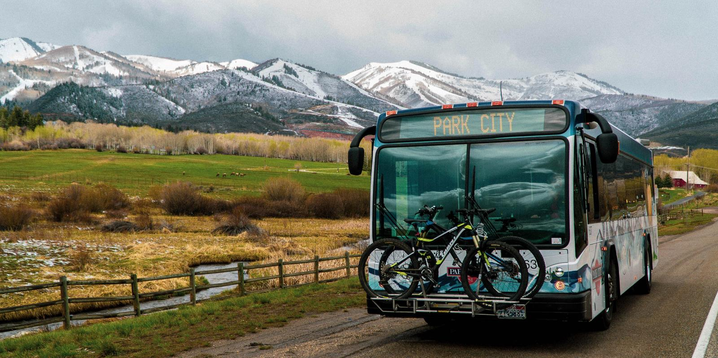

Transportation
  Park City Transit has provided fare-free public transportation in the Park City, UT area since 1975. Today, Park City Transit’s 9 bus routes, 66 full-time and seasonal operators, and 45 vehicles (13 of which are zero emission buses at a cost of $1 million per bus) help transport residents, visitors, festival-goers, and employees alike year-round, 21 hours a day, 365 days a year.
  Park City, as a Rural Transit Agency, receives federal operating assistance through the Utah Department of Transportation (UDOT). On average we receive $2-3 million for operations. FY23 Ops Budget: $14M
  Before the pandemic, we moved 2 million riders (2019). In 2020, during the pandemic, we moved 1 million. Our ridership is coming back, in 2021 we moved 1.5 million people. Transit is an critically important service for the community and visitors.

Slide 30
Transportation Operations
Transportation Operations:
  ITS Transit IT Tech Coordinator
  Upgrade Safety & Training Administer Role
  Two New Supervisors
    System coverage, winter 5:30 am – 3am 7 days a week
    Support customers, assist operators (accidents, late night citywide, weather, coverage for trippers, operator shortages)
    5 supervisors now, vacation, medical leave = holes in coverage
    Assist with bio-brakes for operators, lunches
    Place holder, micro transit pilot

Slide 31
Transportation Fund
Revenue Type | FY22 YTD Actuals | FY22 Adj Budget | FY23 Budget | $, Variance FY22 Bud | %, Var from FY22 Bud
TRANSIT SALES TAX | $6,904,071 | $9,452,759 | $8,637,180 | -$815,579 | -9%
RESORT TAX TRANSPOR | $2,955,997 | $3,821,209 | $3,459,047 | -$362,162 | -9%
BUSINESS LICENSES | $911,949 | $953,297 | $981,896 | $28,599 | 3%
FEDERAL GRANTS (Operating) | $5,599,260 | $6,599,700 | $3,220,298 | -$3,379,402 | -51%
FEDERAL GRANTS (Capital) | $119,163 | $500,000 | $18,493,520 | $17,993,520 | 3599%
REGIONAL TRANSIT REVENUE | $4,051,674 | $4,080,819 | $83,243 | -$3,997,576 | -98%
OTHER FUNDING SOURCES | $592,545 | $576,352 | $576,352 | $0 | 0%
PARKING REVENUES | $2,082,204 | $2,603,364 | $2,603,364 | $0 | 0%
Totals | $23,216,863 | $28,587,500 | $38,054,900 | $9,467,400 | 33%
Expense Type | FY22 YTD Actuals | FY22 Adj Budget | FY23 Budget | $, Variance FY22 Bud | %, Var from FY22 Bud
TRANSPORTATION OPS | $9,711,921 | $11,856,619 | $13,964,203 | $2,107,584 | 18%
TRANSPORTATION PLANNING | $416,137 | $877,374 | $1,034,755 | $157,381 | 18%
PARKING OPS | $1,152,550 | $1,649,073 | $1,949,087 | $300,014 | 18%
CAPITAL PROJECTS | $511,000 | $28,785,368 | $14,292,488 | -$14,492,880 | -50%
Totals | $11,791,608 | $43,168,434 | $31,240,533 | -$11,927,901 | -28%
Ops Revenues | $23,097,700 | $28,087,500 | $19,561,380
Ops Expenses | $11,280,608 | $14,383,066 | $16,948,045
Over/Under | $11,817,092 | $13,704,434 | $2,613,335
FY23 Total Revenues | $23,216,863 | $28,587,500 | $38,054,900
FY23 Total Expenses | $11,791,608 | $43,168,434 | $31,240,533
Over/Under | $11,425,255 | -$14,580,934 | $6,814,367
 |  | FY22 End Bal | FY23 End Bal | Min Rsv
 |  | $3,904,210 | $10,718,577 | $3,389,609

Slide 32
Transportation Fund

Slide 33
Transportation Operations
FY22 Operations Budget - $11,856,619
FY23 Operations Budget - $13,964,203
Operations Increase - $2,107,584
Operations Increase Details:
- Pay Plan $1.1M
- Personnel Request 385K
- O&M $535 (includes $500K for Micro Transit Pilot)
- Electric Bus Charging $80K

Slide 34
Transportation Operations
FY 2023 Budget
Overhead Expenses | 5,040,394
Operators | 5,880,751
P/T Seasonal (for winter months) | 373,629
Transit Administration Staff | 2,738,767
Vacancy Factor | -619,339
Micro Transit Pilot | 500,000
Total Operations Budget | 13,964,202
Total Full Time Operators | 59
Transit Admin Full Time | 20
Total Part Time Operators (seasonal) | 7
Total Year Round Employees | 79
Total Part Time | 7

Slide 35
Overhead Costs
Transportation Operations
Interfund Transfers ($3.3M)
Cellular Cost, Utilities, Electric Charging ($500k)
Electric Fleet Battery Lease ($409k)
Other Expenses, Office Supplies, Uniforms, Equipment ($142k)
Building Administration ($122k)
Department Supplies, R&M, Printing ($191k)
Contract Services (Avail, MakeShift, Optibus, Lobbyist Support $395k)
$5 million

Slide 36
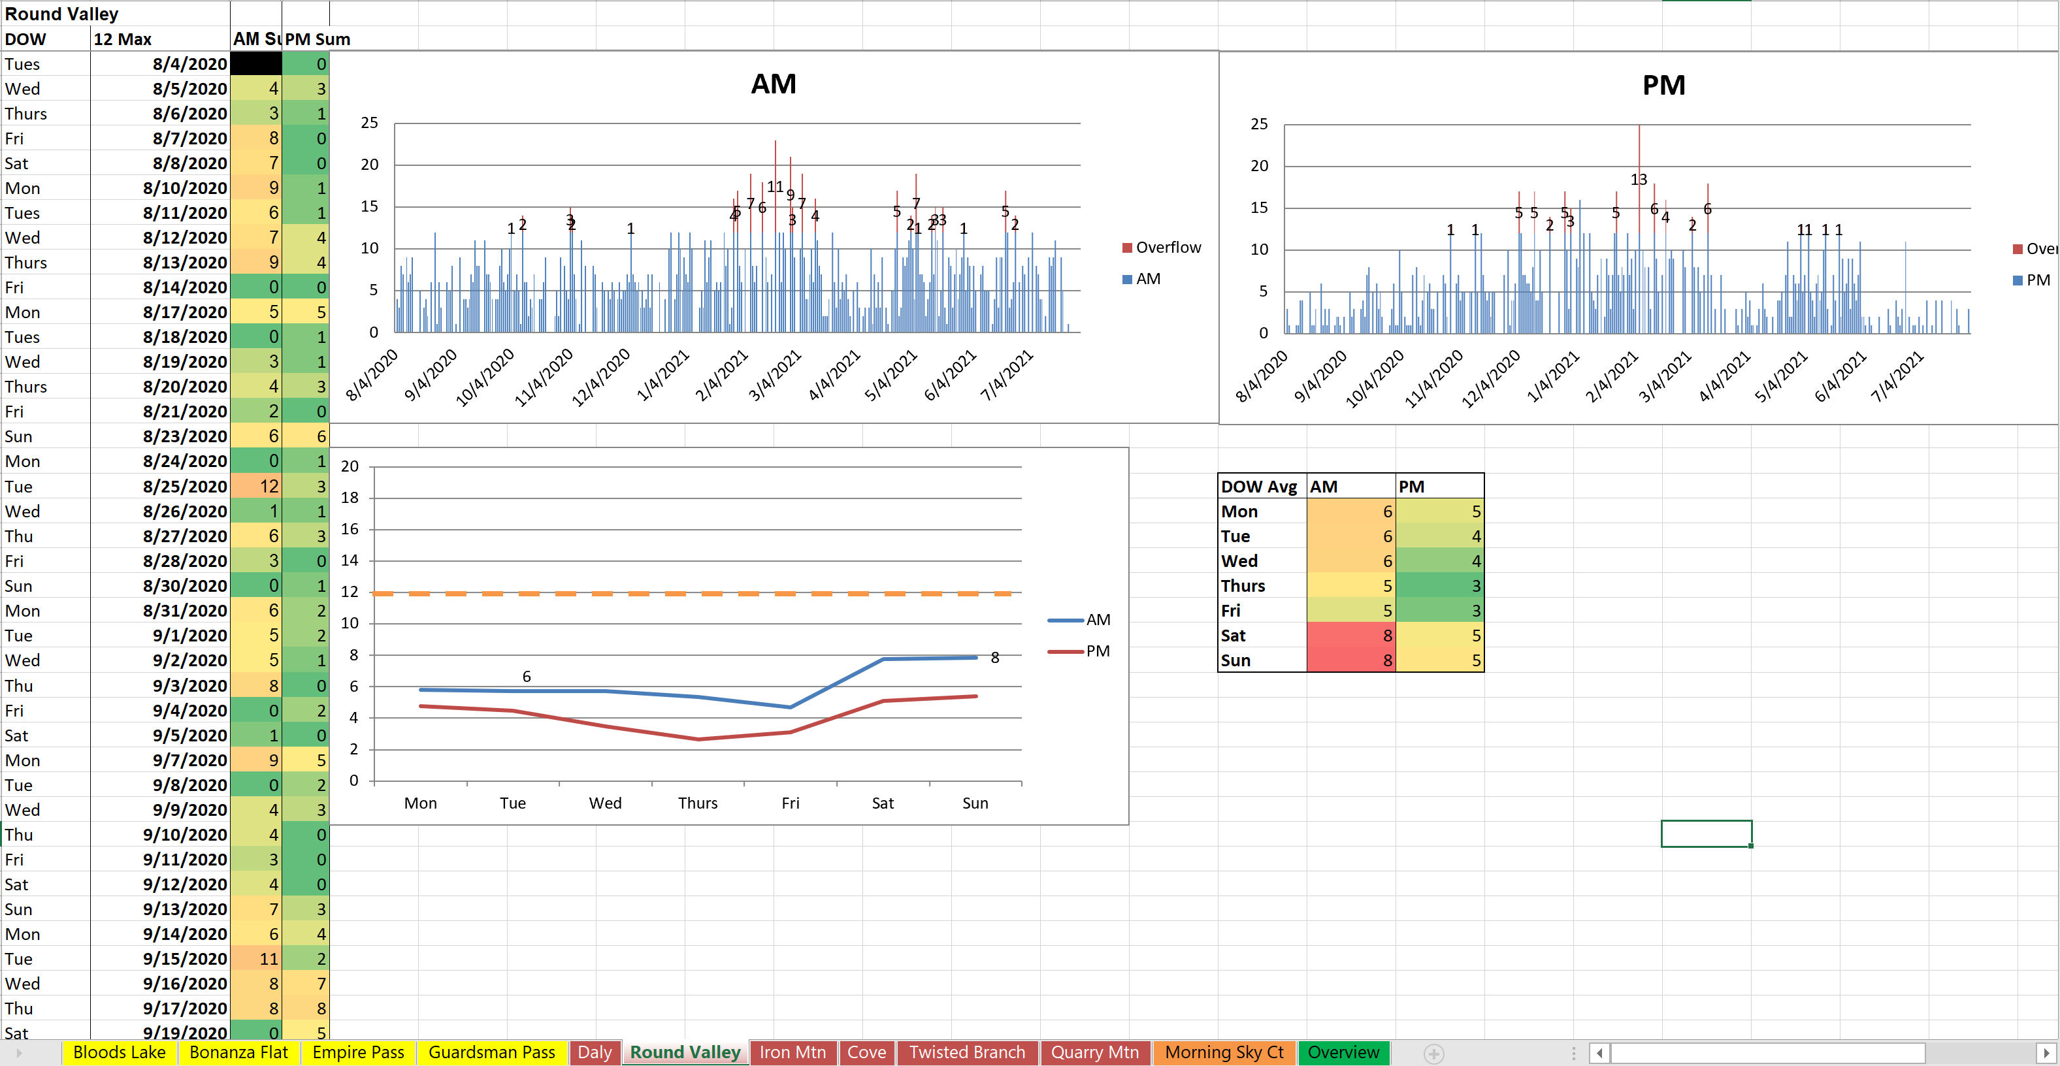

Slide 37

Trails & Open Space
Trails & Open Space
Focus on Trails and Open Space Mitigation, Environmental Initiatives and Trail Improvement Projects
Trails & Open Space Mitigation- (Ranger Program) $115k to increase two part-time Rangers to full-time (partial allocation to Transportation Planning) & $25k two seasonal Rangers
  Raise the level of Service to four
  Two Rangers provide patrols 2-3 times daily in Park Meadows, Iron Canyon, Clark Ranch, Round Valley, Daly Canyon.
  Rangers will collect counts and provide citations if necessary.
  Customer Service/Directions
  Trail Etiquette & Wayfinding
  Trail related special events
  Commercial use data collection
  Staff will provide a monthly update to Council.
  Transit Capital Projects
Bonanza Flat Mitigation- Still working with Wasatch County Sheriff on civil enforcement.
  Provide patrols everyday and provide citations.
  Review other offenses such as overnight parking.
Transit to Trails program- $45k to continue the program.
  Supplemented with 13K CWC grant
  Summit Land Restaurant grant still TBD
  RFP is currently being advertised
  Programming anticipated July 1- October 15.
    Frequency and Routes dependent on additional grant funding

Slide 38

Trails & Open Space
Trail Enhancements - (Rail Trail Winter Grooming/Trash Removal) $7k increase to Winter maintenance contract with Mountain Trails Foundation (MTF)
  Mutt Mitt stations
  Trash Removal
  Winter Grooming
Trail Improvement Projects- Trail Improvement Projects will be addressed in the capital budget discussions on June 9th.
Open Space Environmental Restoration Projects- Restoration Projects will be addressed in the capital budget discussions on June 9th.
Open Space Environmental Goals Wildfire Mitigation – Enhancements to the current Wildfire mitigation efforts will be addressed during the capital budget discussions on June 9th
  April 28 Council direction to include private property in 2022 project deliverables

Slide 39
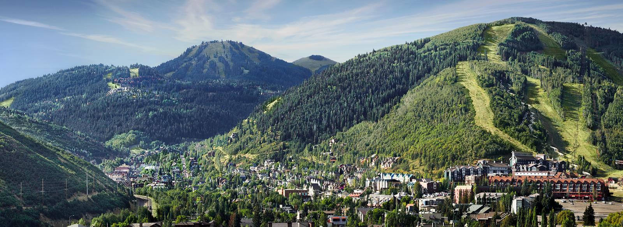
Parking Fund
Parking - $230k
  Reclass four Parking Officers to Transportation Demand Management (TDM) Officers - $35k
  Reclass two Public Works Analysts - $22k
  Subscriptions - $40k
  Supplies, Phone - $6k
  New Parking Officer and Vehicle (traffic mitigation) $127k

Slide 40
Enhanced Traffic Mitigation
Enhanced Focus - Team Approach – Consolidated Effort
$865,000
Public Works
+Traffic Coordination Manager ($144k)
+$150k contract services
Special Events
Logistical support for peak traffic/events
Barricades, message boards, waste management, street cleaning, etc.
Coordinate and manage all City events
Coordinate all traffic-related work through one centralized nerve center
Work with all relevant departments on streamlined approach to traffic mitigation during peak hours/days and events
Resort and stakeholder liaison
+1 additional event vehicle ($14k)
+2 additional peak traffic positions ($204k)
Police Dept
Transportation
Parking Dept
Traffic enforcement
Reduce traffic collisions
Facilitate vehicle and pedestrian traffic flow
Emergency Management
Enhanced transit service during events/peak times
TOC
Enhanced parking management/enforcement during peak traffic/events
Community Engagement
+1 Transit Technology Coordinator, +2 Transit Supervisors
+1 additional traffic officer and vehicle ($226k), +POST training
+1 additional parking officer and vehicle ($127k)
Staff works with neighborhoods to manage traffic/event changes

Slide 41
Infrastructure/IT
Information Technology - $789,100
  Junior Administrators - $138k/ea. (total with wages, benefits, taxes)
  Data Science Tools – $150k
  New ERP/Financial system multi-year implementation as current system is sunsetting (2027 sunset) - $250k
  Virtualization, Streaming, Fiber, Network Maintenance - $34,600
  Case Management Software - $45k
  Departmental webpage updates - $13,500
  Cybersecurity - $20k

Slide 42
IT Cost Distribution
  IT Ops – Mostly covered by General Fund revenues
    Enterprise Funds pay for their services through an interfund transfer (calculated annually)
    IT Ops are centralized except for specialization in Transportation
  IT Capital – Enterprise Funds pay directly for their computer equipment & software

Slide 43
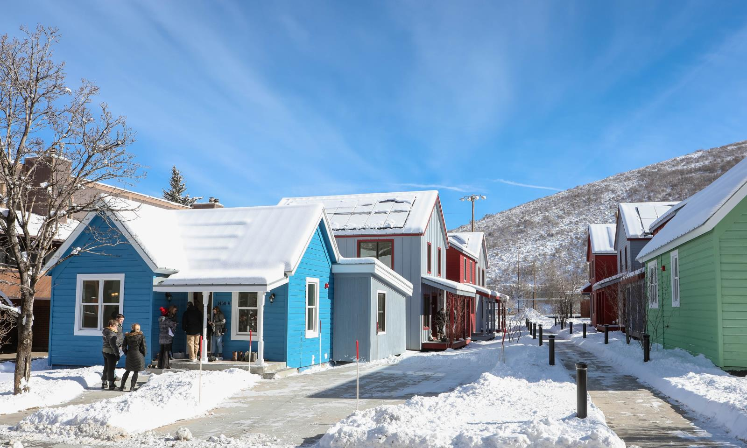
Reinvesting in Neighborhoods
Engineering
  Analyst/Office Asst - $105k
  Software, Training, Supplies, Printing - $14,995
  Neighborhood Traffic Management Program
    Reimagine program to make it more inclusive, less regulatory, and proactive
    $150k - More flexibility in funding to enhance impacts
Planning
  Elevate Planner I position to Senior Planner - $47k
  Public Notices - $19,500
  Training, Phone, Supplies - $10,800
  Consulting - $35k
  General Plan update - $100k
Building
  Books, Uniforms - $4,850
  Four Vehicles - $140k

Slide 44
Reinvesting in Neighborhoods
Police
  New Detective (includes vehicle and equipment) - $223k
  Dispatch Services Contract - $65k
  Take Home Car Program - $40k
Housing
  Additional FTE placeholder - $150k
  Minor repairs/maintenance of City owned units - $14,400
Community Engagement:
  Additional funds to expand support for outreach and community events, such as Catch up With Council and Mayor & Council in the Neighborhood - $13,000
  NCS Survey Tool - comprehensive picture of resident perspectives about local government services, policies, and management - $10k

Slide 45

Recreation
Community Initiatives
Programming that helps to build and strengthen the community for youth & adults
Sliding fee scale for facility & programs based on Summit County AMI
Prioritize Summer Day Camp registration for residents and those that work within the city limits
Received $15K Solomon Fund Grant to help increase Latin X participation in summer day camp
Capital Community Projects:
Replacement of the play feature in the leisure pool at the MARC
Replacement of Prospector Park playground
Replacement of turf field at Park City Sports Complex

Slide 46
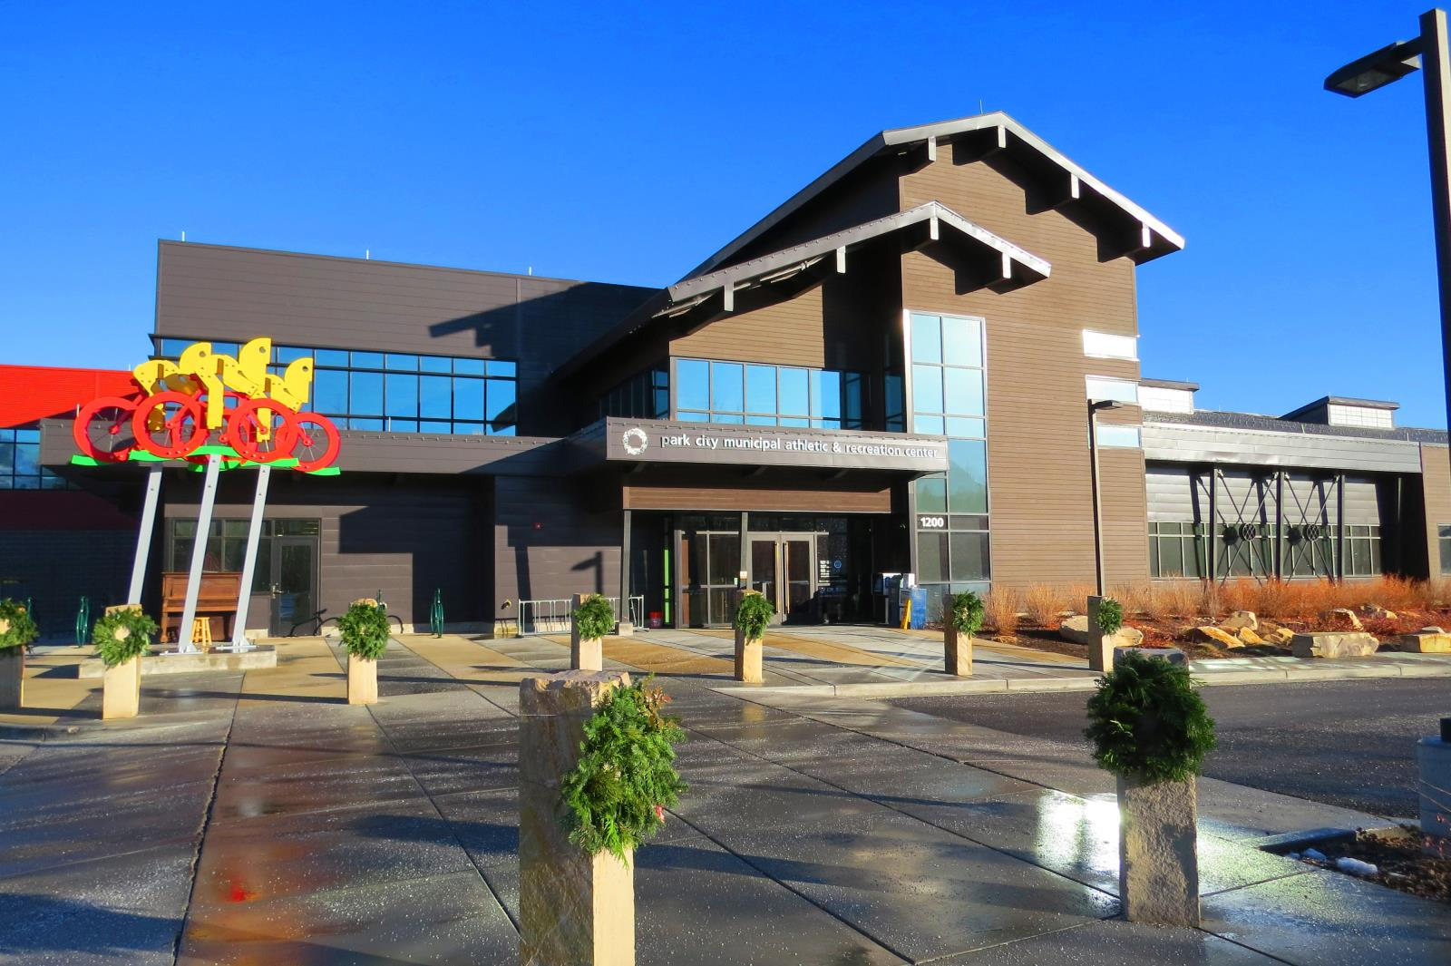
Recreation FY23 Ops Budget
MARC
  Increase Pickleball Instructors to full-time - $41k
  Full-Time Front Desk Staff - $64k
  Conferences/Training - $10k
  Bank Charges - $32k
  Equipment, Chemicals - $17k
  Computers – $8,400
  Software – $10,678
Tennis
  Pro Shop Inventory - $20k for racquets and clothing
  Freight, Office Supplies - $5k
Recreation
  Equipment and Umpires - $1,300

Slide 47
Pay for Performance – Goal Setting and Review Process
Goal Setting
Exec Team sets City goals to ensure PCMC strategy is achieved through department outcomes. Goals are communicated and assigned to staff - June/July
Measure Performance
Annual Self Review and Manager Review. Peer Reviews are encouraged for all and required for Managers. Results are compiled either by Manager or Trakstar (software) - Measured throughout year
Appraisal
Reviews are audited by Human Resources; Manager then discusses final review with employee. –April/May
Outcomes
Two possible outcomes
Employee is recommended for Lump Merit (Bonus)
Employee is recommended for Corrective Action and/or Performance Plan. – June

Slide 48
Pay Plan & Personnel
2020 75th percentile base salary + CPI adjustment of 10.33% = FY23 maximum pay range
Transit Pay Plan based on current market data
Actual pay based on performance

Slide 49
New Personnel Requests
(amounts include wages, benefits, taxes, etc.)

Slide 50
New Personnel Requests
(amounts include wages, benefits, taxes, etc.)
New positions account for 36% of personnel increase (~$2.4M)

Slide 51
FY23 Operating Budget
Human Resources - $268,400
  1.5 FTEs - New Recruiter and increased support for benefits/onboarding - $143k
  Reclass Generalists - $2,400
  Recruitment/Retention - Education Assistance, Recruiting Programs, Employee Assistance/Wellness Program, Supplies - $83k
  Contract Services - $40k
Legal
  Contract Services - $25k for environmental legal services
Environmental Regulatory
  Consulting/Contract Services - $35k
Finance - $27k
  New laptops - $6k
  Audit and Bank Charges - $20k
  Training, Cellular - $1k

Slide 52
FY23 Operating Budget
Ice - $20,400
  Reclass Head of Ice Ops from Contractor to FTE (HR recommended) - neutral
  Outdoor Ice Tech - $12,800
  Computers, Supplies - $7,600
Library - $14,500
  Postage, printing, memberships, marketing - $6,200
  Materials and Books - $8,300 digital resources geared toward pre-K-3rd grade, genealogy database, Sustainability Resource Center

Slide 53
FY23 Operating Budget
Building Maintenance - $211,500
  Bldg Maint IV – $30,500 (shared with Water, total for position is $122k)
  Bldg Maint III - $105k
  Contract Services, Supplies - $45k
  Vehicle - $36k
Parks - $35k
  Seasonal Staff - $30k
  Equipment and materials - $5k
Streets - $227k
  Striping - $8k
  Street signs - $15k
  Streets III (2) - $204k
Golf Fund - $45,500
  Inventory increase, Uniforms, Bank Charges - $39k
  Contract Services, Fertilizer, Sand, Plant Materials - $16,500

Slide 54
Appendix

Slide 55
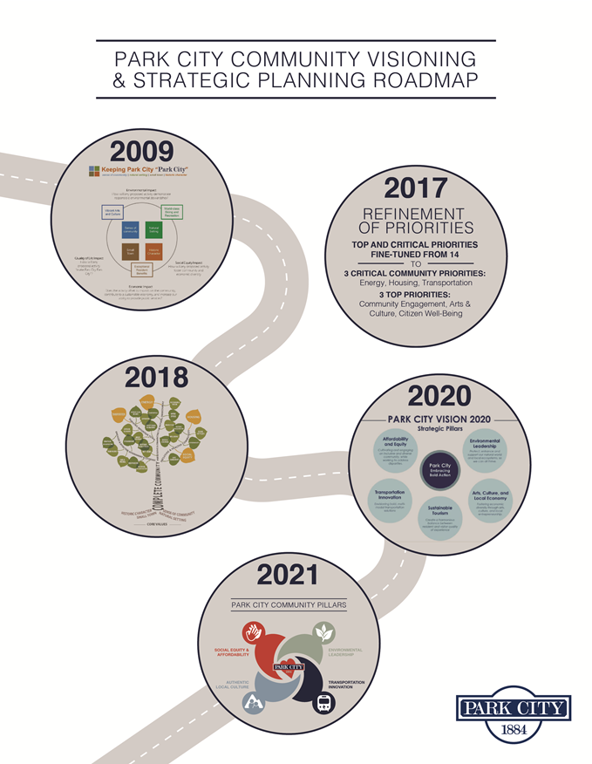

Slide 56





Community Visioning
Park City Vision 2020 activities kicked off in June 2019 and concluded in February 2020
1700 participants shared their feedback on Park City’s vision throughout the 8-month project
From neighborhood gatherings to stakeholder visioning sessions to the Park City Vision 2020 Future Summit, public engagement was extensive and well attended
Participated in the Park City Vision 2020 Think-Tank and Strategic Pillar Focus Groups to add perspective, subject matter expertise, and guidance throughout the visioning process
Five Strategic Pillars were identified to address Affordability & Equity; Art, Culture & Local Economy; Environmental Leadership; Transportation Innovation; and Sustainable Tourism
8
Months
1700
Participants
40 Engagement
Events
95
Community
Leaders
5
Strategic
Pillars

Slide 57
Budgeting for Outcomes
Strategic
Create direct link between what Council wants and how the budget is allocated
Cost Effective
Council and the public can see how taxpayer dollars are achieving their goals
Staff time and energy optimized by directing them toward the most important strategic outcomes
Prioritize budget based off of better cost estimates for projects, programs, and services

Slide 58
BFO Strategies
  Priority-driven budget process based upon Council’s priorities, goals, objectives, and desired outcomes
  Internal budget committees develop the final budget proposal. Committees are made up of cross-departmental staff, including the Results Team, CIP, Pay Plan, Benefit, and Fleet committees, and other ad hoc committees as needed
  The Results Team formulates recommendations based on total BFO score, manager’s request, established need, available resources, and related performance measures

Slide 59
Simple Scoring Scale –
“Degree” of Relevance to a Result
4 = Program has an essential or critical role in achieving Result
3 = Program has a strong influence on achieving Result
2 = Program has some degree of influence on achieving Result
1 = Program has minimal (but some) influence on achieving Result
0 = Program has no influence on achieving Result
“High Degree” of Relevance
“Lower Degree” of Relevance (still a clear connection)
No Clear Connection

Slide 60
1. Program Aligns with Council Goals
Programs that are identified as Essential or Critical by Council score higher. Those programs identified as a "Top Priority" will score below that. Any other programs will score below that.
Weight = 2.0
4 points = Essential or Critical Priority as identified by Council
3 points = Top Priority as identified by Council
2 points = Other focus area identified as a Council Desired Outcome
1 points = Bid includes some justification on how it addresses the Desired Outcomes
0 points = Bid includes bad or no justification on how it addresses the Desired Outcomes

Slide 61
2. Portion of Community
Served by Program
Programs that benefit or serve a larger segment of the City’s residents, businesses and/or visitors will receive a higher score for this attribute compared to programs that benefit or serve only a small segment of the population.
Weight = 1.0
4 points = Program benefits/serves the ENTIRE community and adds to their quality of life
3 points = Program benefits/serves a SUBSTANTIAL portion of the community and adds to their quality of life
2 points = Program benefits/serves a SIGNIFICANT portion of the community and adds to their quality of life
1 points = Program benefits/serves SOME portion of the community and adds to their quality of life
0 points = Program benefits/serves only a SMALL portion of the community, but still adds to their quality of life

Slide 62
3. Reliance on City to Provide Program
Programs will be graded on the degree of reliance residents have on the City to provide a service as compared with their ability to obtain the same or a similar service from another intergovernmental agency or a private business. Programs for which residents can only look to the City will receive a higher score for this attribute compared to programs that are offered by other providers.
Weight = 1.0
4 points = City is the sole provider of the service and there are no other public or private entities that provide this type of service
3 points = City is the sole provider but there are other public or private entities which could be contracted to provide this service
2 points = Program is only offered by another governmental, non-profit or civic agency
1 points = Program is offered by other private businesses not within City limits
0 points = Program is offered by other private businesses within City limits

Slide 63
4. Change in Demand for Program
Programs demonstrating an increase in demand or utilization will receive a higher score for this attribute compared to programs that show no growth in demand for the program or service. Programs demonstrating a decrease in demand or utilization will actually receive a negative score for this attribute.
Weight = 1.0
4 points = Program experiencing a SUBSTANTIAL increase in demand of 25% or more
3 points = Program experiencing a SIGNIFICANT increase in demand of 15% to 24%
2 points = Program experiencing a MODEST increase in demand of 5% to 14%
1 points = Program experiencing a MINIMAL increase in demand of 1% to 4%
0 points = Program experiencing NO change in demand
-1 points = Program experiencing a MINIMAL decrease in demand of 1% to 4%
-2 points = Program experiencing a MODEST decrease in demand of 5% to 14%
-3 points = Program experiencing a SIGNIFICANT decrease in demand of 15% to 24%
-4 points =Program experiencing a SUBSTANTIAL decrease in demand of 25% or more

Slide 64
5. Mandated to Provide Program
Programs that are mandated by another level of government (i.e. federal, state or county) will receive a higher score for this attribute compared to programs that are mandated solely by the City or have no mandate whatsoever.
Weight = 1.0
4 points = Required by Federal, State or County legislation
3 points = Required by Charter or other incorporation documents OR to comply with regulatory agency standards
2 points = Required by Code, ordinance, resolution or policy OR to fulfill franchise or contractual agreement
1 points = Recommended by national professional organization to meet published standards or as a best practice
0 points = No requirement or mandate exists

Slide 65
6. Effectiveness of Proposal
Program demonstrating meaningful measures to gauge effectiveness will receive a higher score. If budget increases are requested, manager addresses how performance measures will be affected by the request.
Weight = .75
4 points = Program includes meaningful and effective performance measures
3 points = Program includes reasonable performance measures
2 points = Program includes adequate performance measures
1 points = Program includes below average performance measures
0 point = Program includes bad or no performance measures

Slide 66
7. Cost Recovery of Program
Programs that demonstrate the ability to “pay for themselves” through user fees, intergovernmental grants or other specifically dedicated revenues will receive a higher score for this attribute compared to programs that generate limited or no funding to cover their cost.
Weight = .5
4 points = Earmarked funds exist specifically for the program (such as a grant or debt)
3 points = Program draws on flexible revenues which are specific to the Fund (such as Water, Transit, and Golf Funds) or program draws entirely on non-earmarked funds for which it has a particularly reasonable claim (Recreation, Ice, BPE fees, Admin IFTs, etc.)
2 points = Program draws mostly on non-earmarked funds for which it has a particularly reasonable claim (Recreation, Ice, BPE fees, Admin IFTs, etc.)
1 points = Program partially draws on non-earmarked funds for which it has a particularly reasonable claim (Recreation, Ice, BPE fees, Admin IFTs, etc.)
0 point = Funds are not identified or funds are subject to much competition (such as the General Fund)

Slide 67
8. Cost Savings/Innovation/Collaboration
Programs that demonstrate ability to find savings or innovate will be scored higher.
Weight = .25
4 points – Major cost savings or efficiencies are gained
3 points = Obvious cost savings or efficiencies are gained
2 points = Some cost savings or efficiencies are gained
1 points = Little cost savings or efficiencies are gained
0 points = No cost savings or efficiencies are gained

Slide 68
City BFO Programs (Services)
  Include one department or multiple departments working in partnership/collaboration with each other
  Describes what a service, program, or activity will do to help achieve the Council-approved goals
  Need to explain the scope of the service and any enhancements or decreases to level of service
  Explain any cost savings, innovation, or collaboration that their program would be able to accomplish during the next fiscal year
  Includes performance measures tailored specifically to that service used to measure its success

Slide 69
Program Scoring by Theme

Slide 70
Program Scoring by Theme

Slide 71
Program Scoring by Theme

Slide 72
Program Scoring by Priority

Slide 73
Program Scoring by Priority

Slide 74
Program Scoring by Priority

Slide 75
Results Team Recommendation
  High rating of a program will not guarantee that a program will be retained; nor does it guarantee that a lower-ranking program will be proposed for elimination
  Rankings may not reflect whether a program is being delivered in the most efficient manner
  Prioritization process provides valuable information for budget proposal development and City Council deliberation

Slide 76
Role for Managers
Derive budget from strategies and objectives (not from last year’s budget)
Identify and provide essential services
Decide what does and does not fit
Establish clear links with Council’s goals and desired outcomes
Cost out programs
Meet performance measure targets
Report on performance of programs
Onus on them to defend their programs
Better bids/offers may receive higher scores

Slide 77

The Role of the Budget Office
The Budget Dept should…
  Be unbiased
  Advocate for the process and the best outcomes rather than a particular department
  Validate logic and evidence
  Advise departments on technical aspects
  Understand cause and effect relations
  Establish clear links between programs and the organization’s priorities
  Evaluate links from an organization-wide perspective and validate efficiencies, identify other opportunities for improving value
  PERFORMANCE MANAGEMENT
  Set standards to measure and evaluate programs
  Act as intermediary between managers & Results Team

Slide 78

Results Team Priorities
Establish Results Team as “Buying Agents”
  Managers plus some non-managers (high-performers)
  Representatives from throughout City
  Wear “citizen’s hat”
  Challenge the status quo
  Encourage innovation and new ideas
  Link bids to desired outcomes
  Vet managers’ budget submissions
  Agree on program scores
  Take ownership of process
  Present united recommendation
  “The most controversial aspect of BFO is that it puts a great deal of trust in thoughtful non-experts to make good decisions and to encourage or force experts to start thinking outside the box. If this basic premise is not accepted, BFO will not generate the preferred results.”

Slide 79

City Manager Role
  Support and be advocate for process
  Become knowledgeable on the variety and diversity of programs offered
  Offers input on programs to Results Team when needed
  Reviews and amends Results Team recommendation based on Council Goals, Desired Outcomes
  Propose budget based off of Results Team recommendation

Slide 80
Citywide Purchasing Goals
We are seeking proposals that:
Provide excellent value in meeting community needs.
Provide top quality for a world class, multi-seasonal/resort community.
Provide for gains in efficiency and/or cost savings.
Leverage collaboration or partnerships with other departments and/or external organizations.
Are innovative and creative.
Consider best practices.
Reduce low value-added activities.
Promote environmental stewardship.
Consider short/long-term financial impacts.
Ensure sound management of resources and business practices.

Slide 81
Committee Roles
Dept Requests
Results Team
Pay Recommendation
Compensation Committee
(Blue Ribbon Commission)
Health Insurance
Benefits Committee
Capital Recommendation
Special Service Contracts
CIP Committee
SSC Subcommittee
City Manager’s Recommended Budget

Slide 82
March Sales Tax Update

Slide 83
General Fund

Slide 84
Sales Tax Summary – General Fund
General Fund - Sales Tax Summary - Monthly
Month | FY19 Actual | FY20 Actual | FY21 Actual | FY22 Original Budget | FY22 Actual
July | $812,668 | $890,546 | $767,523 | $664,517 | $1,047,907
August | $730,497 | $839,320 | $777,490 | $893,477 | $1,171,593
September | $754,343 | $912,173 | $991,597 | $896,914 | $1,132,767
October | $533,991 | $715,887 | $735,086 | $740,255 | $934,102
November | $805,462 | $820,365 | $995,487 | $685,164 | $1,328,051
December | $1,644,270 | $1,877,541 | $1,709,314 | $1,593,658 | $2,326,666
January | $1,915,943 | $2,167,578 | $1,587,251 | $1,593,658 | $2,346,656
February | $1,795,614 | $1,936,051 | $1,915,684 | $1,761,076 | $2,798,863
March | $2,160,171 | $1,318,256 | $2,175,133 | $2,124,877 | $2,790,344
April | $509,306 | $374,250 | $792,166 | $810,883
May | $591,398 | $439,622 | $742,106 | $688,812
June | $771,332 | $603,136 | $1,186,465 | $880,395
Total | $13,024,993 | $12,894,725 | $14,375,301 | $13,333,686
Source: Park City Municipal Corporation. As of May 2022.

Slide 85
Sales Tax Summary – General Fund
General Fund - Sales Tax Summary - $ Change
Month | FY20 Actual vs. FY19 Actual | FY21 Actual vs. FY20 Actual | FY22 Actual vs. FY20 Actual | FY22 Actual vs. FY21 Actual | FY22 Actual vs. FY22 Budget
July | $77,879 | ($123,023) | $157,361 | $280,384 | $383,390
August | $108,823 | ($61,829) | $332,273 | $394,102 | $278,116
September | $157,830 | $79,424 | $220,594 | $141,170 | $235,853
October | $181,897 | $19,198 | $218,214 | $199,016 | $193,846
November | $14,903 | $175,122 | $507,686 | $332,565 | $642,887
December | $233,271 | ($168,227) | $449,125 | $617,352 | $733,008
January | $251,635 | ($580,327) | $179,078 | $759,405 | $752,998
February | $140,438 | ($20,367) | $862,812 | $883,179 | $1,037,787
March | ($841,914) | $856,876 | $1,472,088 | $615,211 | $665,467
April | ($135,056) | $417,916
May | ($151,776) | $302,484
June | ($168,196) | $583,329
Total | ($130,267) | $1,480,576 | $4,399,231 | $4,222,384 | $4,923,353
General Fund - Sales Tax Summary - % Change
Month | FY20 Actual vs. FY19 Actual | FY21 Actual vs. FY20 Actual | FY22 Actual vs. FY20 Actual | FY22 Actual vs. FY21 Actual | FY22 Actual vs. FY22 Budget
July | 10% | -14% | 18% | 37% | 58%
August | 15% | -7% | 40% | 51% | 31%
September | 21% | 9% | 24% | 14% | 26%
October | 34% | 3% | 30% | 27% | 26%
November | 2% | 21% | 62% | 33% | 94%
December | 14% | -9% | 24% | 36% | 46%
January | 13% | -27% | 8% | 48% | 47%
February | 8% | -1% | 45% | 46% | 59%
March | -39% | 65% | 112% | 28% | 31%
April | -27% | 112%
May | -26% | 69%
June | -22% | 97%
Total | -1% | 11%
Source: Park City Municipal Corporation. As of May 2022.

Slide 86
Sales Tax Summary – General Fund
Source: Park City Municipal Corporation. As of May 2022.

Slide 87
Sales Tax Summary – General Fund
Source: Park City Municipal Corporation. As of May 2022.

Slide 88
Sales Tax Summary – General Fund
Source: Park City Municipal Corporation. As of May 2022.

Slide 89
Sales Tax Summary – General Fund
Source: Park City Municipal Corporation. As of May 2022.

Slide 90
Capital Fund

Slide 91
Sales Tax Summary – Capital Fund
Capital Fund - Sales Tax Summary - Monthly
Month | FY19 Actual | FY20 Actual | FY21 Actual | FY22 Original Budget | FY22 Actual
July | $627,203 | $704,479 | $548,052 | $518,076 | $816,105
August | $529,229 | $616,238 | $555,028 | $696,578 | $895,269
September | $577,009 | $759,286 | $699,815 | $699,259 | $867,890
October | $378,251 | $555,393 | $527,415 | $577,123 | $725,811
November | $635,932 | $629,796 | $794,579 | $534,173 | $1,111,541
December | $1,344,356 | $1,570,492 | $1,374,419 | $1,242,459 | $2,079,436
January | $1,693,495 | $1,923,089 | $1,303,836 | $1,242,459 | $2,094,045
February | $1,596,315 | $1,765,073 | $1,670,788 | $1,372,983 | $2,545,965
March | $1,938,349 | $1,087,888 | $1,853,829 | $1,656,611 | $2,504,356
April | $340,118 | $206,191 | $561,565 | $632,187
May | $390,732 | $218,762 | $509,536 | $537,017
June | $528,340 | $369,764 | $892,170 | $686,380
Total | $10,579,328 | $10,406,450 | $11,291,032 | $10,395,302
Source: Park City Municipal Corporation. As of May 2022.

Slide 92
Sales Tax Summary – Capital Fund
Source: Park City Municipal Corporation. As of May 2022.

Slide 93
Sales Tax Summary – Transient Room Tax
Transient Room Tax
Monthly | FY19 Realized | FY20 Realized | FY21 Realized | FY22 Realized | FY22 vs. FY21, $ Variance | FY22 vs. FY21, % Variance
July | $155,919 | $180,669 | $114,918 | $201,780 | $86,862 | 76%
August | $108,460 | $125,677 | $112,872 | $206,192 | $93,320 | 83%
September | $140,971 | $221,639 | $125,348 | $200,321 | $74,973 | 60%
October | $78,769 | $139,424 | $104,921 | $179,897 | $74,976 | 71%
November | $163,248 | $150,563 | $210,795 | $315,172 | $104,377 | 50%
December | $332,107 | $412,832 | $336,374 | $650,240 | $313,865 | 93%
January | $490,668 | $565,442 | $328,467 | $630,062 | $301,595 | 92%
February | $475,570 | $546,738 | $479,315 | $778,153 | $298,838 | 62%
March | $582,847 | $292,669 | $509,063 | $767,199 | $258,136 | 51%
April | $55,730 | $17,479 | $116,391
May | $60,892 | $3,114 | $94,854
June | $87,903 | $36,423 | $208,432
Total | $2,733,084 | $2,692,669 | $2,741,751
Source: Park City Municipal Corporation. As of May 2022.

Slide 94
Sales Tax Summary – Transient Room Tax
Source: Park City Municipal Corporation. As of May 2022.

Slide 95
Sales Tax Summary – Transient Room Tax
Source: Park City Municipal Corporation. As of May 2022.

Slide 96
Sales Tax Summary – Transient Room Tax
Source: Park City Municipal Corporation. As of May 2022.

Slide 97
Transportation Fund

Slide 98
Sales Tax Summary – Transportation Fund
Transportation Fund - Sales Tax Summary - Monthly
Month | FY19 Actual | FY20 Actual | FY21 Actual | FY22 Original Budget | FY22 Actual
July | $370,330 | $507,735 | $431,048 | $374,274 | $608,068
August | $328,650 | $476,867 | $441,580 | $503,230 | $686,058
September | $340,448 | $517,995 | $570,321 | $505,166 | $618,912
October | $234,717 | $409,895 | $419,670 | $416,932 | $544,337
November | $372,095 | $480,163 | $583,067 | $385,903 | $790,856
December | $785,302 | $1,129,662 | $1,019,746 | $897,591 | $1,401,122
January | $933,912 | $1,319,546 | $955,215 | $897,591 | $1,431,732
February | $869,901 | $1,187,380 | $1,164,026 | $991,886 | $1,726,996
March | $1,052,427 | $775,863 | $1,316,569 | $1,196,788 | $1,698,476
April | $222,826 | $194,288 | $446,180 | $456,711
May | $260,629 | $412,635 | $416,661 | $387,958
June | $357,095 | $148,275 | $684,361 | $495,862
Total | $6,128,331 | $7,560,305 | $8,448,444 | $7,509,890
Source: Park City Municipal Corporation. As of May 2022.

Slide 99
Sales Tax Summary – Transportation Fund
Source: Park City Municipal Corporation. As of May 2022.

